Slide 1
No Place for Gun in Schools
National Ecybermission - project submission -2018

Slide 2
What is the problem we are trying to address?
We are trying to address the Gun violence that's ravaging our country - especially in schools
Motto: There should be no place for Guns in Schools. We want the learning to happen in schools without fear or violence.
Our design statement:
Make the schools safe from fire arms and Guns. Our design of the prototype involves, finding the ways to identify the firearm, alert the school, track the individual with the fire arms within the premises and track and find the profile of the individual carrying the fire arm.

Slide 3
What are the reasons for Gun Violence in Schools
Unsecured Fire arm from home / Friend’s / Relative’s house.
School confrontations leading to gun violence.
Medical illness and student mental illness causing the gun related violence.
Outsiders (External) trying to get maximum publicity causing unprecedent violence (Example: Sandy hook Elementary)
Kids in schools considering the guns as toys and bringing in guns to school to impress the peers resulting in unintended violence

Slide 4
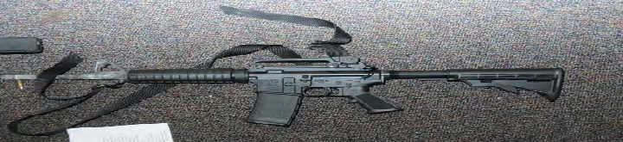
Type of Guns
Fire arms are classified into 3 broad types
Hand Guns
Rifles
Short Guns
(Rifles and Short Guns are considered as long guns as well)
Semi Automatic: Fires one bullet each time, ejects the shell, and loads the next shell.
Fully Automatic: Fires multiple bullets with single pull of trigger.
Hand Guns are the most commonly used for single victim violences.
AR Rifles (AR-15) are the weapon of choice for the mass shooters ( including Sandy hook , Parkland (FL) shooting.
 | Image of the AR15 semi automatic used in Sandy Hook elementary school shooting. A similar one was used in Parkland(FL) shooting as well.

Slide 5
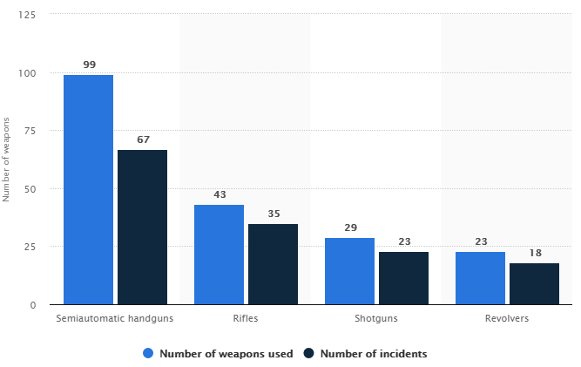
Gun Violence by “type of weapon”
 | Semi automatic weapon like AR-15 accounts for majority of the mass shootings Revolvers and hand guns accounts for majority of single victim shootings 160 school shootings across 38 states.
Weapon types used in mass shootings in US between 1982-2017, source: Statista.

Slide 6
What are our options to stop gun violence in schools and public places?
As the federal ban of assault weapons and firearms is such a contentious issue, it is our responsibility to make the learning area such as schools, colleges and universities violence free and free from any type of fire arms.
Our solution is to develop a prototype, which will
Identify the presence of gun in school premises and public places
It would help in tracking the gun and raising the immediate alert
The app would disable the gun
The app would help in finding the profile of the gun owner real time

Slide 7

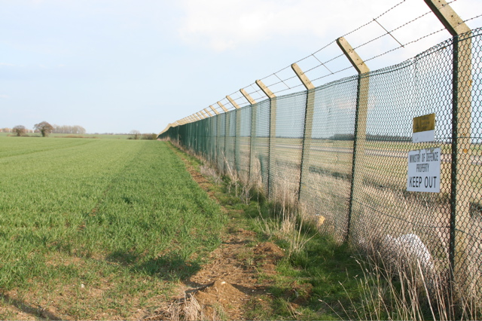

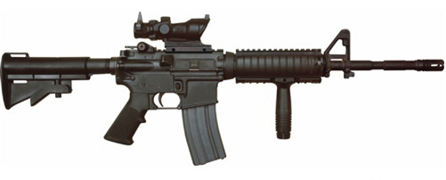

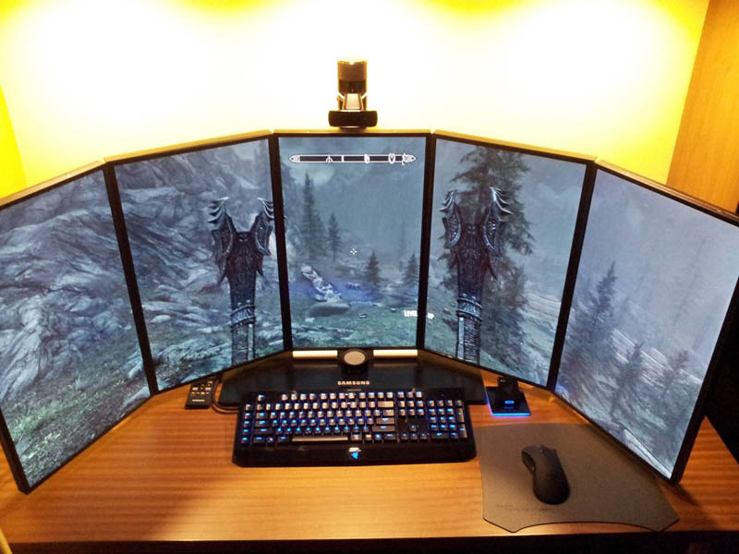


Real time monitoring of Fire Arm movement
Sensor (BlueTooth/IR)
GPS Tracker in the firearm
Geo Fence (Centralized – Identify the firearm with in the geo Fence)
School Premises and monitoring
Trigger the signal to deactivate
Signal to deactivate the Firearm
Once the Firearm info is obtained thru Blue Tooth, communicate with Cloud Services to find the owner/background to mitigate any security risks
Alarm – FireArm detection

Slide 8
Architecture diagram – Model Prototype
Back end DB
(AWS RDS)
Invoke AWS API for background checks
Arduino
(Modelling the Microchip on the firearm)
Mobile App (Modelling in premise monitoring Station)
Trigger AWS SNS for Email / SMS trigger Alerts
Blue Tooth Detection and Communication
Mini GPS Tracker
Servo Motor Logic control for activation/deactivation
Communicating the status to Monitoring Station
Blue Tooth Detection and Communication
Trigger Alarms
Track the Status
Pull the background info on the firearms / Owner
Trigger the Deactivation until the facts are ascertained.

Slide 9
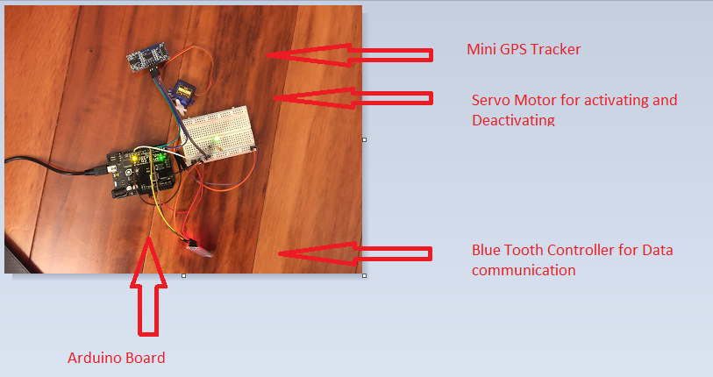
Arduino Prototype – Microchip Design
Arduino Microchip prototype
Blue Tooth Communication
Servo Motor for activating and deactivating based on the control codes.
Mini GPS Tracker for Location Tracking

Slide 10
Criteria for successful solution
Ability to recognize the firearm through data communication via Blue Tooth enabled microchip
Ability to pass the information about the Serial Number, Type , GPS location coordinates through communication channels
On the receiving end recognizing the code and serial number, trigger the alarm for the immediate attention.
Triggering the Alarms through mass communication Email / SMS in the network
Based on the Equipment Serial Number, pull the Information about the Fire arm through globally managed equipment profile background info via Web API
Identification of the original owner of the equipment and perform background check
Track the background history of the owner through Web API
Communicating back to the equipment to disable the equipment if required.

Slide 11
PROBLEMS – RELATED TO LEGAL FRAMEWORK
There are already existing firearms in the market which doesn’t have the microchip installed. Since the design is based on the smart arm using microchip, it should be legally mandated to have this installed on the existing firearms in the market.
Owners and firms should agree to allow the microchip to be installed and it should be mandated with the legal framework.
The privacy issues with the tracking of the Gun should be made as mandatory for owning the gun.
When the gun is outside of the owner premises, the framework requires tracking of the Gun through partnership with Manufacturers, owners and the tracking firm

Slide 12
PROBLEMS –RELATED TO TECHNOLOGY
This requires the fire arm to be powered through current. If the firearm is not charged with the battery backup, the fire arm might be inoperable.
The distance of the communication using Bluetooth is not infinite. It is intended for short range communication. So enough receiving signals should be present to recognize the Bluetooth communication.
Bluetooth mechanism requires authentication from both the parties. The framework should be adjusted so that the sending signal always accepts and sends the communication from the known legal entities like schools and public places based on the predefined secret code.
Sensors using Infrared might be prone to obstacles. So IR sensor might not be very effective in passing the communication.
Disabling of the firearm based on the predefined authorization code requires mechanical infrastructure to trigger the equipment in-operable.
GPS tracking requires the communication mechanism to pass the location information. One way is once the communication is established, the GPS information can be passed through Bluetooth data communication channel, or it could given the generic authentication to connect to Guest WIFI in the premises. Otherwise firearms also would require mobile access plans like the cell phones to track their precise information and pass the same. If the owners are mandated to install the low cost GPS tracking and the monthly maintenance for the network cost, then the solution to track the device through GPS tracker is a viable option and it shouldn’t be allowed to be disabled if the equipment is taken outside of the premises

Slide 13
Ideas for future improvement
Geofencing:
The idea behind the Geofencing is to automatically disable any firearm in a predefined locations. This includes public places, school premises and learning institutions. The technology can be built into firearm to get it automatically disabled when it is in the geofenced area.
The same idea can be enhanced to make the firearm active only in the predefined places.
Tracking of fire arms in public places:
Universal product identification and tracking of all fire arms when it is in public places should be considered as a safety measure. If the commercially owned firearm is present in public places, it location should be tracked and its life cycle and owner history should be available instantaneously to the law enforcement.
Biometric Identification for operation of the Fire Arms:
Biometric authentication and identification can be incorporated into firearms to make sure that the owner is the one operating the firearm. As the data shows the incidents do happen because of theft and forceful acquisition of the firearm, this would help to make sure that only the original owner is allowed to operate the firearm.
Controlling the capacity and delivery of the ammunition based on the Geo Location:
The capacity and delivery of the ammunition should be controlled only on specific areas and in public places. The loading of the ammunition should be one ammunition at a time. This will be great benefit when mass violence is being tried to be perpetrated in the learning places such as schools or in public places.

Slide 14
Conclusion
The argument on right to bear the arms is ever ongoing. The solution really lies on how the current trends in technology can make the future ideas possible, and can make a true difference
As our prototype showed, it is possible to identify/track/alarm/check the background details and even deactivate the firearm if public safety is an issue.
A life saved cannot be measured in terms of profit or loss, right or wrong of ideologies
Technology is a game changer. The current trends in AI (Artificial intelligence, Cloud Technologies, Geo Tracking and Microchip controlled smart intelligence) would lead the way for addressing the common problems with a futuristic solution.
If one positive alert identified and tracked can save one young life, we have found the purpose in the technology.
Life is too precious to be lost to another gun violence. Every small step in the right direction counts.

